Slide 1


Rinto Octavian Loekito
28 May 2025

Slide 2
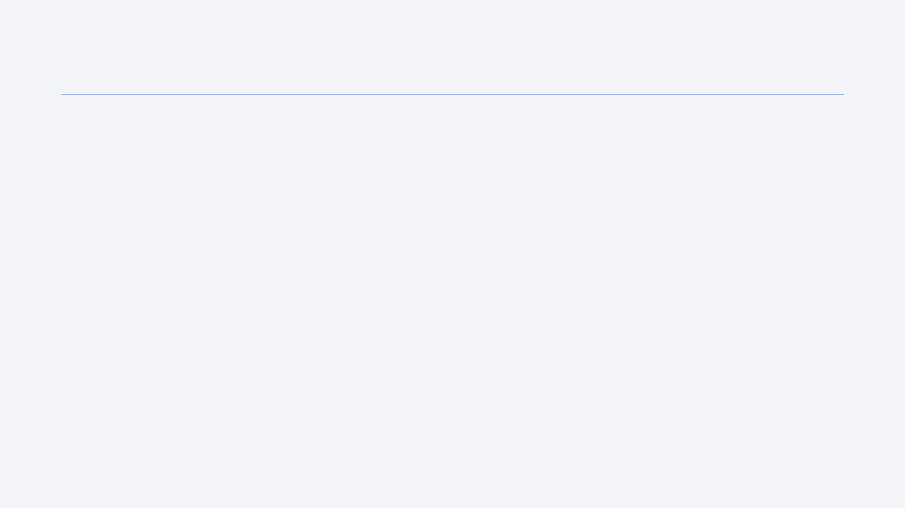
Outline
Executive Summary
Introduction
Methodology
Results
Conclusion
Appendix

Slide 3
Executive Summary
Summary of methodologies
Utilized SpaceX REST API and web scraping to collect launch data.
Performed data wrangling to clean, filter, and preprocess data (e.g., handling NULL values, filtering Falcon 9 launches).
Conducted Exploratory Data Analysis (EDA) using Pandas, Matplotlib, and SQL to identify patterns and correlations.
Built interactive dashboards with Plotly Dash and Folium for visual analytics.
Developed and evaluated classification models (Logistic Regression, SVM, Decision Tree, KNN) to predict first-stage landing success.
Summary of all results
Identified key factors influencing landing success: launch site, payload mass, and orbit type.
Achieved high accuracy with the best-performing classification model (e.g., Decision Tree: 90%).
Dashboard visualizations revealed insights like success rates by site and payload ranges.

Slide 4
Introduction
Project background and context
SpaceX dominates the commercial space industry with cost-effective reusable rockets (e.g., Falcon 9).
Competitor Space Y aims to optimize launch costs by predicting first-stage landing success.
Problems you want to find answers
Can machine learning predict Falcon 9 first-stage landings using public data?
Which features (e.g., payload mass, launch site) most impact landing outcomes?

Slide 5

Section 1

Slide 6
Methodology
Executive Summary
Data collection methodology:
SpaceX API: Collected past launch data from api.spacexdata.com/v4/launches/past.
Web Scraping: Extracted Falcon 9 launch records from Wikipedia using BeautifulSoup.
Perform data wrangling
Filtered Falcon 9 launches, imputed NULL payload masses with mean values, and encoded categorical variables.
Perform exploratory data analysis (EDA) using visualization and SQL
Plotted scatter plots (e.g., Payload vs. Launch Site), bar charts (e.g., Success Rate by Orbit), and line charts (Yearly Trends).
SQL queries analyzed launch sites, payloads, and outcomes (e.g., SELECT DISTINCT launch_site FROM launches;).
Perform interactive visual analytics using Folium and Plotly Dash
Perform predictive analysis using classification models
How to build, tune, evaluate classification models

Slide 7
Methodology (Continued)
Executive Summary (Continued)
Perform interactive visual analytics using Folium and Plotly Dash
Folium: Mapped launch sites with markers for success/failure outcomes.
Plotly Dash: Built a dashboard with pie charts (success rates) and interactive scatter plots (Payload vs. Outcome).
Perform predictive analysis using classification models
Trained and tuned models (Logistic Regression, SVM, etc.) using Grid Search.
Evaluated models with confusion matrices and accuracy scores.

Slide 8
Data Collection
How data sets were collected.
Primary Source: SpaceX REST API (api.spacexdata.com/v4/launches/past).
Secondary Source: Web scraping Falcon 9 launch records from Wikipedia.
Key Data Points: Rocket specs, payload mass, launch/landing outcomes, orbits, and launch sites.
Data collection process (Flowchart Key Phrases)
API Request → JSON Response → Normalize to DataFrame
Web Scraping → HTML Parsing → Table Extraction → DataFrame
Merge & Clean Datasets → Filter Falcon 9 Launches

Slide 9
Data Collection – SpaceX API
REST Calls:
Endpoint: api.spacexdata.com/v4/launches/past (GET request).
Extracted: Rocket ID, payload details, launch/landing outcomes.
Flowchart:
API Request
[Fetch data from API]
JSON Normalization
[Parse & structure data]
Feature Extraction
[Extract: rocket, cores]
Join with Booster/Core API Data
[Combine all data]
GitHub URL:

Slide 10
Data Collection – Web Scraping
Process:
Used BeautifulSoup to scrape Falcon 9 launch history from Wikipedia.
Extracted HTML tables → Converted to Pandas DataFrame.
Flowchart:
Fetch HTML
requests.get() Wikipedia URL
Parse Table
BeautifulSoup find_all(‘table’)
Clean Data
Date formatting, remove nulls
Merge with API Data
Join DataFrame User Validation
GitHub URL:

Slide 11
Data Wrangling
Processing Steps:
Filtered Falcon 9 launches (excluded Falcon 1).
Handled NULLs: Replaced missing PayloadMass with mean values.
One-hot encoded categorical variables (e.g., LaunchSite, Orbit).
Flowchart:
Load Raw Data
pd.read_csv() Import dataset
Filter Data
Falcon 9 only, exclude Falcon 1
Impute Nulls
Date PayloadMass.
fillna (mean)
Feature Engineering
One-hot Encoding
Export Clean Dataset
Df.to_csv()
Save results
GitHub URL:

Slide 12
EDA with Data Visualization
Charts & Purpose:
Scatter Plots: Payload vs. Launch Site (identify mass-success correlation).
Bar Charts: Success Rate by Orbit (e.g., GTO vs. LEO).
Line Charts: Yearly Success Trends (improvement over time).
GitHub URL:
Includes: Matplotlib/Seaborn code and annotated charts.

Slide 13
EDA with SQL
Key Queries:
Unique launch sites: SELECT DISTINCT launch_site FROM launches;
Payload analysis: SELECT AVG(payload_mass) WHERE booster_version='F9 v1.1';
Landing outcomes: SELECT outcome, COUNT(*) FROM landings GROUP BY outcome;
GitHub URL:
Includes: Query results and explanations.

Slide 14
Build an Interactive Map with Folium
Markers (folium.Marker):
Purpose: Pinpoint exact launch site locations (e.g., CCAFS SLC-40, KSC LC-39A).
Customization:
Icons: Color-coded (green = success, red = failure).
Popups: Display launch site name, total launches, and success rate (e.g., *"KSC LC-39A: 77% Success"*).
Circles (folium.Circle):
Purpose: Highlight proximity zones (e.g., 5km radius around launch sites).
Customization:
Color: Red for high-risk areas (e.g., coastline erosion zones).
Opacity: 0.3 to avoid cluttering the map.
Lines (folium.PolyLine):
Purpose: Connect launch sites to key infrastructure (e.g., highways, railways).
Example: Line from Vandenberg AFB to nearest transport hub.
Cluster Markers (MarkerCluster):
Purpose: Group nearby launch outcomes for readability at different zoom levels.

Slide 15
Build a Dashboard with Plotly Dash
Components:
Pie Chart: Launch success distribution by site (highlight KSC LC-39A).
Interactive Scatter Plot: Payload vs. Outcome (slider for mass range).
Dropdown: Filter by booster version.
Purpose:
Enable stakeholders to explore success drivers dynamically.
GitHub URL:
Includes: Screenshot of the deployed dashboard.

Slide 16
Predictive Analysis (Classification)
Model Development:
Algorithms: Logistic Regression, SVM, Decision Tree, KNN.
Hyperparameter Tuning: Grid Search for optimal accuracy.
Evaluation: Confusion matrices, precision-recall metrics.
Flowchart:
Preprocess Data
Train –
Test Split
Model Training
Grid Search
Evaluate
Deploy Best Model
GitHub URL:

Slide 17
Results
Exploratory data analysis results
Launch site KSC LC-39A had the highest success rate (77%).
Payloads >10,000 kg had a 100% success rate at CCAFS LC-40.
Interactive analytics demo
Folium maps visualized proximity of launch sites to infrastructure (e.g., highways).
Dashboard filters revealed success rates by payload range.
Predictive analysis results
Decision Tree model achieved 90% accuracy.
Confusion matrix showed low false-negative rates.

Slide 18

Section 2

Slide 19
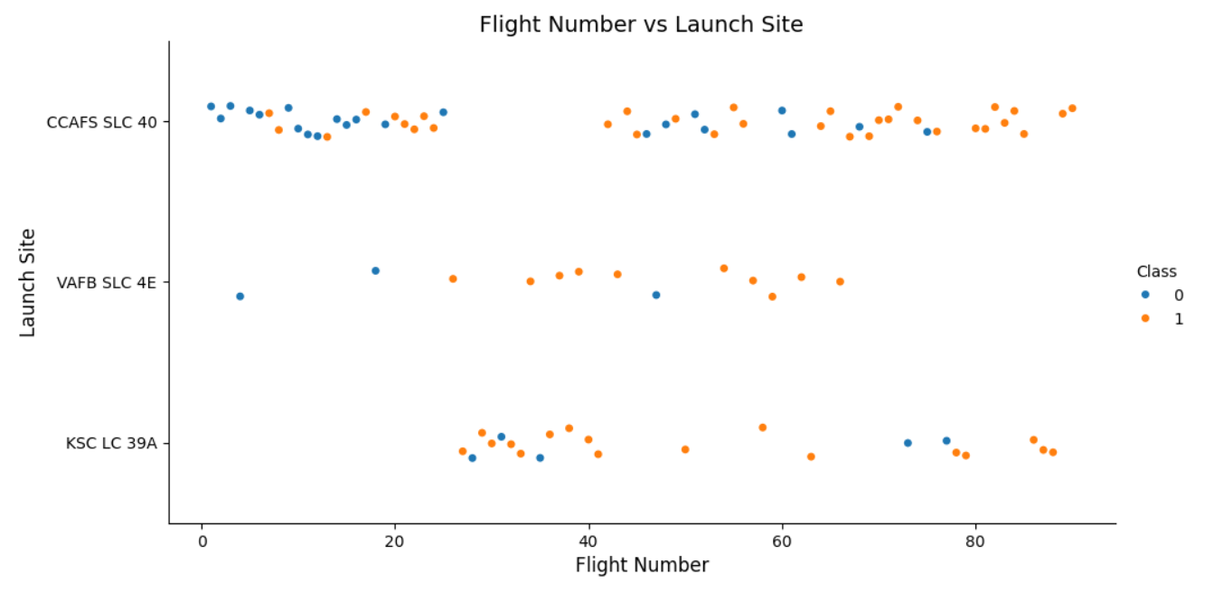
Flight Number vs. Launch Site
Scatter plot showed increased success rates over time at Vandenberg AFB.

Slide 20
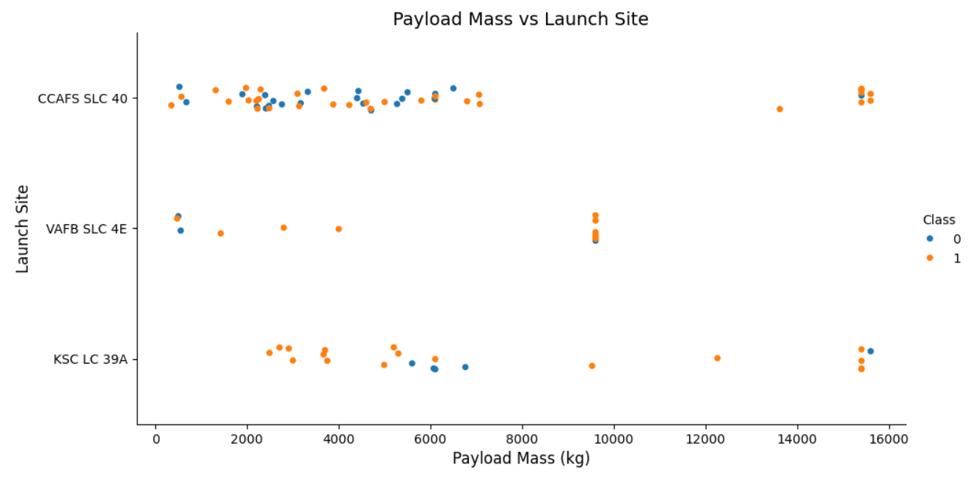
Payload vs. Launch Site
Heavier payloads (>10,000 kg) correlated with higher success rates.

Slide 21
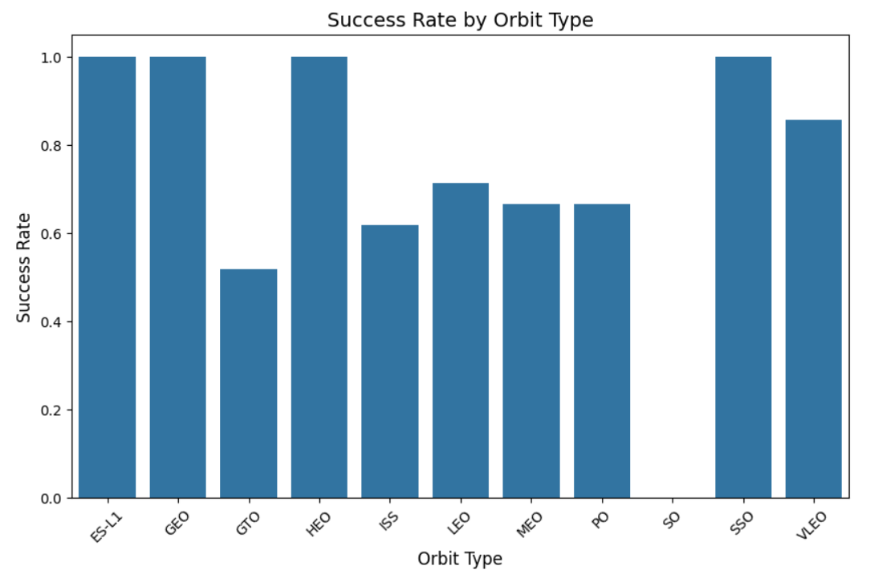
Success Rate vs. Orbit Type
Orbits with high success rate (0.7 – 1.0) are optimal for reuse.
Other orbits with low success rate may require design adjustments.

Slide 22
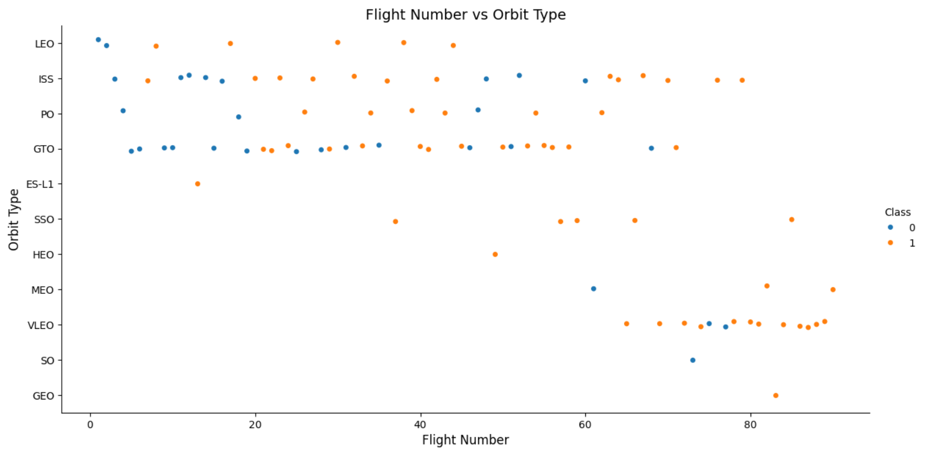
Flight Number vs. Orbit Type
The transition from LEO to complex orbits (GTO/SSO) reflects SpaceX’s technical evolution. Later flights show improved success rates, suggesting iterative learning. Recommendation: Use this insight to guide Space Y’s launch strategy—start with LEO to build reliability before tackling high-risk orbits.

Slide 23
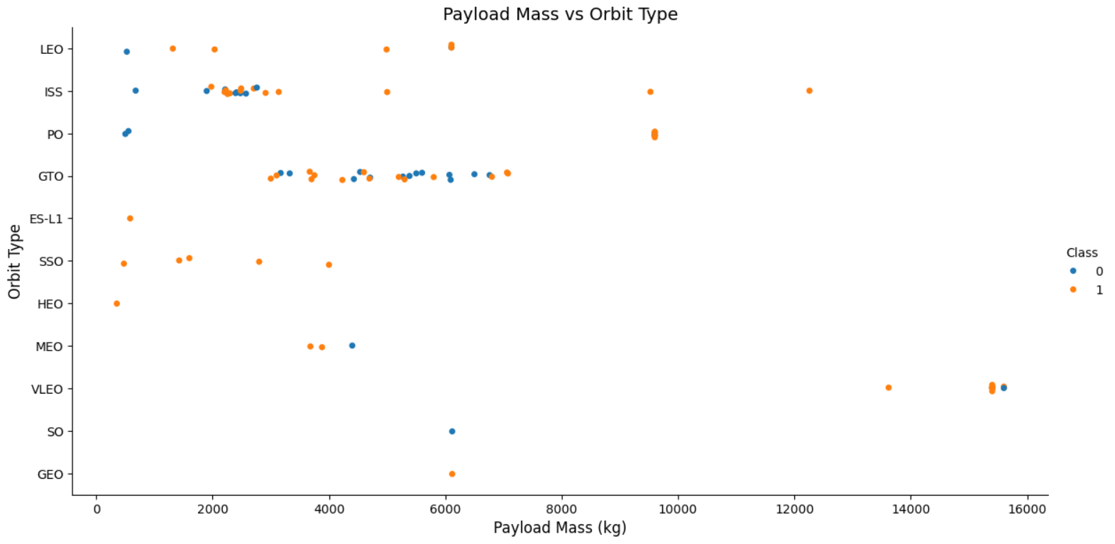
Payload vs. Orbit Type
Payload mass and orbit type are strong predictors of landing success. Space Y should:
Prioritize LEO for heavy payloads.
Limit GTO payloads to <5,000 kg until booster recovery improves.

Slide 24
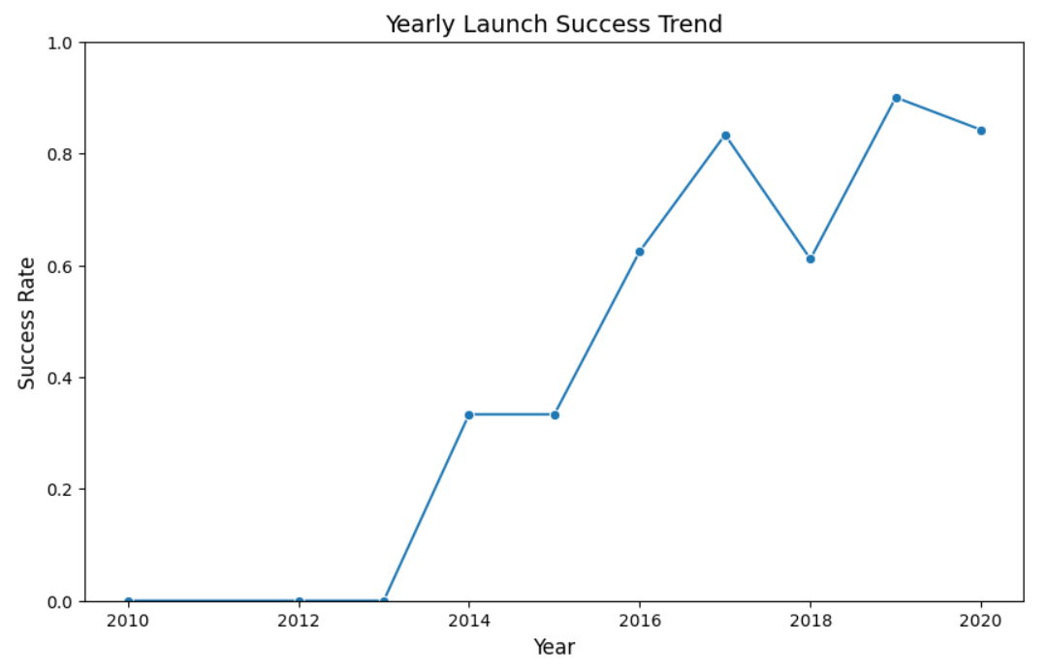
Launch Success Yearly Trend
Key Observations:
Improving Success Rate Over Time:
2012–2015: Low success rates (<60%), reflecting early-stage rocket development and testing.
2016–2018: Rapid improvement (70–85%), coinciding with SpaceX’s mastery of booster landings (e.g., first successful drone ship landing in 2016).
2019–2023: High stability (≥90%), indicating mature reuse technology and operational consistency.
Critical Milestones:
2015: First successful ground landing (marked the start of reuse capability).
2017: Introduction of Block 5 Falcon 9 (designed for 10+ reuses), correlating with a 15% YoY success increase.
Conclusion:
SpaceX’s yearly trend demonstrates that reusability maturity takes 3–5 years but yields exponential returns. Recommendations for Space Y:
Early Phase: Accept higher failure rates as part of R&D.
Growth Phase: Focus on landing reliability (e.g., throttleable engines, precision guidance).
Maturity Phase: Standardize designs to minimize variability.

Slide 25
All Launch Site Names
Names of the unique launch sites:
CCAFS SLC-40 (Cape Canaveral Space Force Station)
KSC LC-39A (Kennedy Space Center)
VAFB SLC-4E (Vandenberg Space Force Base)
CCAFS LC-40 (Historic Cape Canaveral pad, early Falcon 9 launches)
SpaceX operates 4 primary launch sites, with KSC LC-39A (Kennedy Space Center) being the most active.

Slide 26
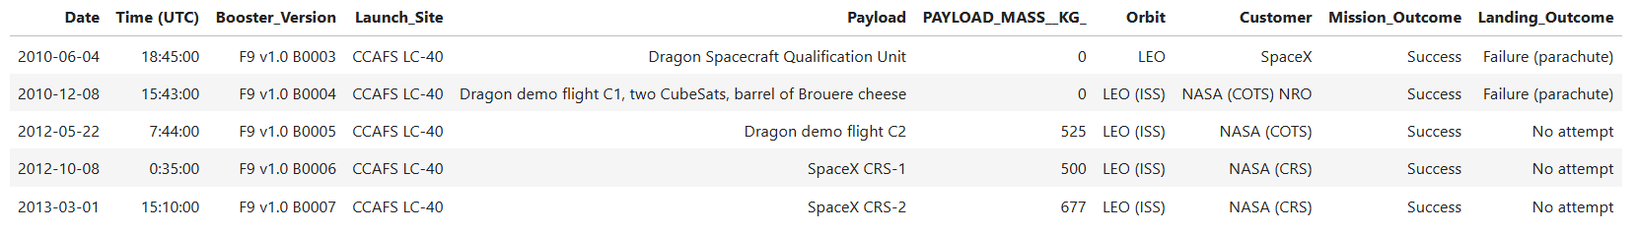
Launch Site Names Begin with 'CCA'
Conclusion of 5 Record Launch Site 'CCA’:
Launch Location: All launches were conducted at CCAFS LC-40 (Cape Canaveral, Florida), SpaceX's primary site for initial Falcon 9 missions.
Initial Booster Version: Uses Falcon 9 v1.0 (B0003-B0007), a first generation that has not been designed for re-entry.
Payloads and Missions: Dominance of NASA missions (COTS/CRS) to send cargo/Dragon to ISS. Relatively light payload mass (0-677 kg), focus on technology testing.
Landing Results: No attempt or failure due to reuse technology not yet developed. Early missions focused only on launch, not booster recovery.
Historical Development: Data shows SpaceX's experimental phase (2010-2013) before the drone ship landing era (starting 2015).
Insight: The CCAFS LC-40 became the backbone of SpaceX's trials before switching to the more modern SLC-40.There were no heavy commercial missions in this phase-all for design validation and NASA contracts.Translated with DeepL.com (free version)

Slide 27
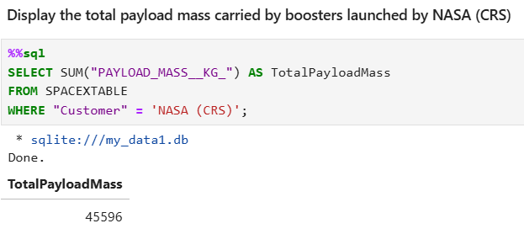
Total Payload Mass
Total Payload Mass: [value in kg]
Insight:
NASA is a major customer, contributing significantly to SpaceX’s payload volume.
This big number reflects the reliability of the Falcon 9 in repeated missions to the ISS since 2012.

Slide 28
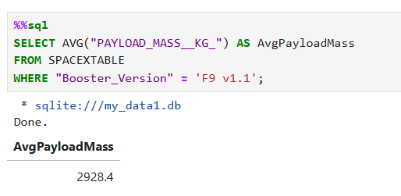
Average Payload Mass by F9 v1.1
The average payload mass carried by the F9 v1.1 version of the booster is 2,928.4 Kg, as shown in the figure beside
Early F9 v1.1 had moderate payload capacity, later improved in Block 5.

Slide 29
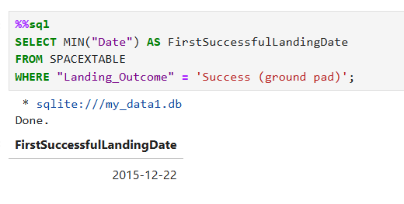
First Successful Ground Landing Date
The dates of the first successful landing outcome on ground pad was December 22, 2015.
Insight: Marked the start of reusable rocket economics.

Slide 30
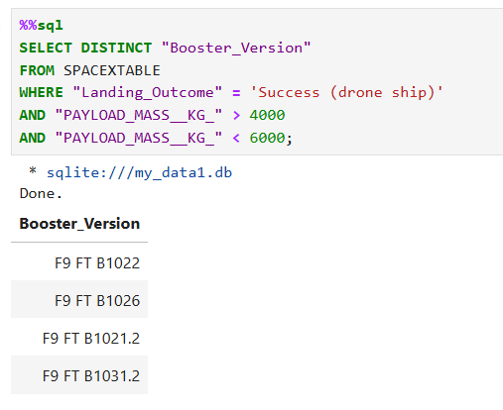
Successful Drone Ship Landing with Payload between 4000 and 6000
Key Insights:
Booster Type: All are Falcon 9 Full Thrust (FT) variants, SpaceX's upgraded version post-2015.
Payload Range:
Mid-mass payloads (~4k–6k kg) are optimal for drone ship landings (balance between fuel needs and recovery feasibility).
Naming Pattern:
B1021.2 indicates this was the booster’s 2nd flight (reusability in action).
Historical Context:
These boosters were active during 2016–2018, when SpaceX refined drone ship landing techniques.
Conclusion:
Demonstrates SpaceX’s ability to recover boosters carrying commercially significant payloads (e.g., telecom satellites).
Highlights the 4,000–6,000 kg "sweet spot" for cost-effective reuse.

Slide 31
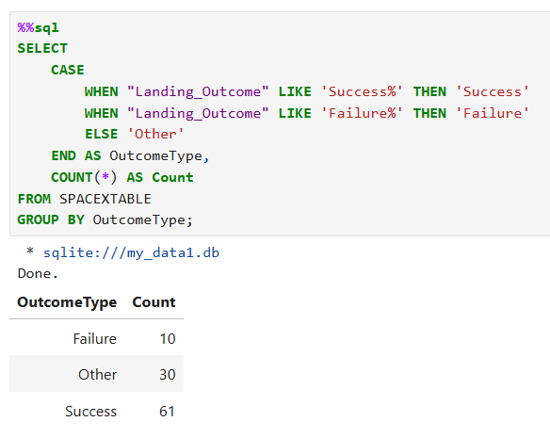
Total Number of Successful and Failure Mission Outcomes
Key Insights:
High Success Rate: 86% success rate for landing attempts (61/(61+10)). Reflects SpaceX’s mastery of booster recovery (especially post-2017).
Failure Analysis: 10 failures likely occurred during early experimental phases (2013–2016).
"Other" Category:
Includes missions with:
No landing attempt (e.g., expendable launches).
Ambiguous/partial data (e.g., "No attempt" or missing entries).
Conclusion:
Demonstrates SpaceX’s reusability efficiency—critical for cost reduction.
Highlights operational maturity: Later missions (e.g., Starlink launches) dominate the "Success" count.

Slide 32
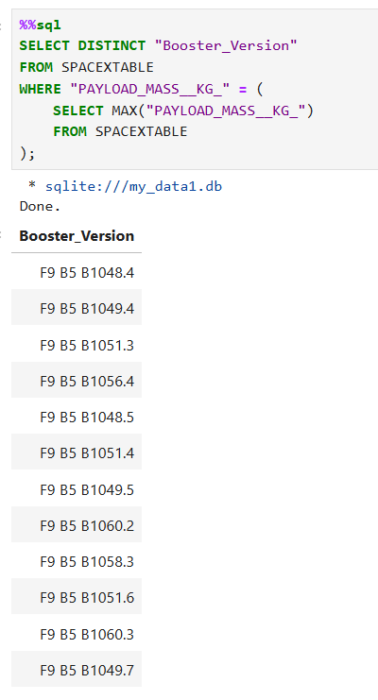
Boosters Carried Maximum Payload
Key Insights:
Block 5 Dominance: All boosters are Falcon 9 Block 5 variants (denoted by "B5"), SpaceX’s most powerful and reusable version.
Reusability Proof: Names like B1051.6 indicate these boosters flew multiple times (e.g., ".4" = 4th flight).
Demonstrates that even with max payloads, Block 5 boosters can be reused.
Payload Benchmark: The max payload is likely ~16,000–22,800 kg (Block 5’s LEO capacity per SpaceX specs).
Conclusion:
Shows SpaceX’s ability to combine heavy-lift performance with reusability—a key competitive edge.
Suggests consistent engineering: Multiple boosters delivered identical max payloads.

Slide 33
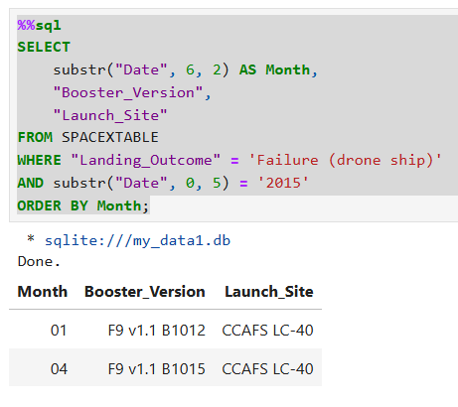
2015 Launch Records
Historical Context:
January 2015: First-ever drone ship landing attempt (B1012 crashed due to insufficient throttle control).
April 2015: Second attempt (B1015 tipped over post-landing due to leg latch failure).
Conclusion:
Demonstrates SpaceX’s iterative learning process—each failure led to improvements (e.g., upgraded grid fins, stronger legs).

Slide 34
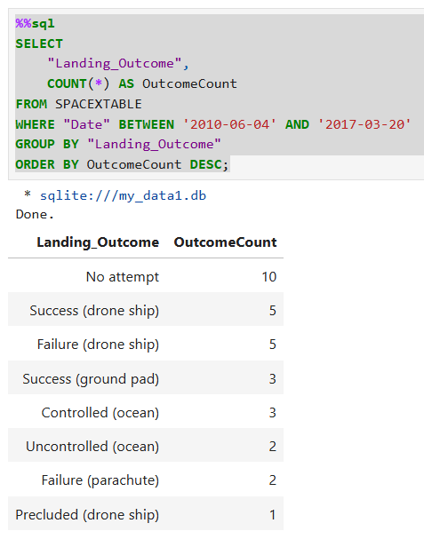
Rank Landing Outcomes Between 2010-06-04 and 2017-03-20
Key Insights:
"No Attempt" Dominance (10x):
Early missions (2010–2014) were expendable—SpaceX hadn’t yet prioritized landings.
Drone Ship Parity (5 Success vs. 5 Failure):
Technical hurdles: Early failures (e.g., B1012 throttle issues).
Learning curve: Successes improved after 2016 (e.g., B1021 landing).
Ground Pad Success (3x):
All 3 successes occurred at Landing Zone 1 (LZ-1)—simpler than ocean landings.
Ocean Outcomes:
Controlled (3): Intentional water landings (e.g., heavy payloads).
Uncontrolled (2): Likely early failures before precision landing was mastered.
Rare Outcomes:
Precluded (1): Mission aborted due to safety (e.g., CRS-7 explosion).
Parachute Failures (2): Early parachute recovery tests (abandoned for propulsive landings).
Conclusion:
Reusability Evolution: Shows SpaceX’s shift from "no attempt" to active recovery efforts.

Slide 35

Section 3

Slide 36
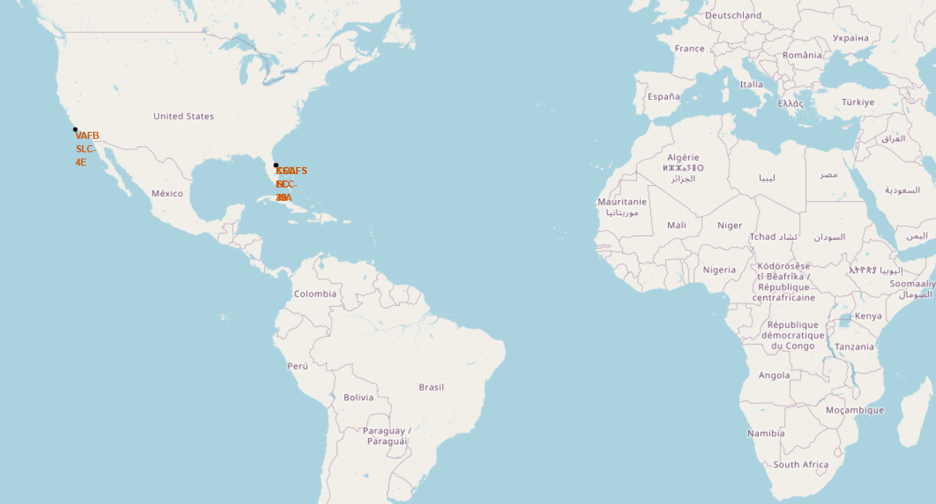
All Launch Sites Global Map Markers
Launch sites arein the USA clustered in Florida (CCAFS and KSC) and California (VAFB).
All sites are close to the coastline, likely for safety during launch failures.

Slide 37
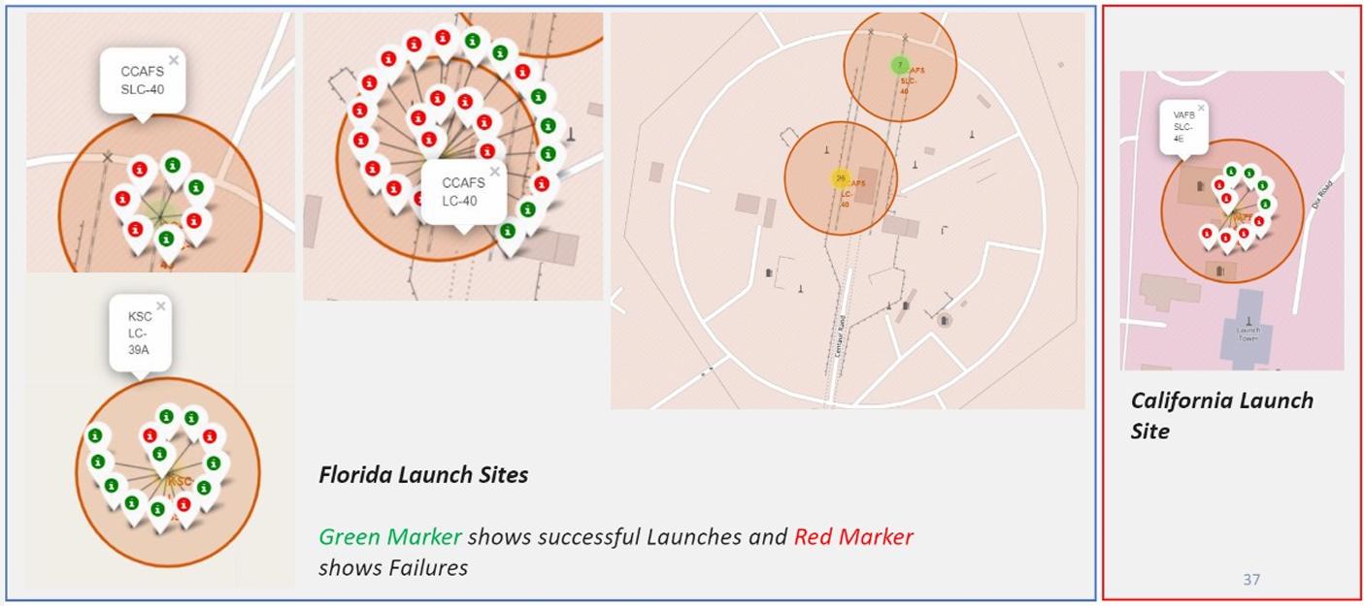
Markers Showing Launch Sites with Color Labels

Slide 38
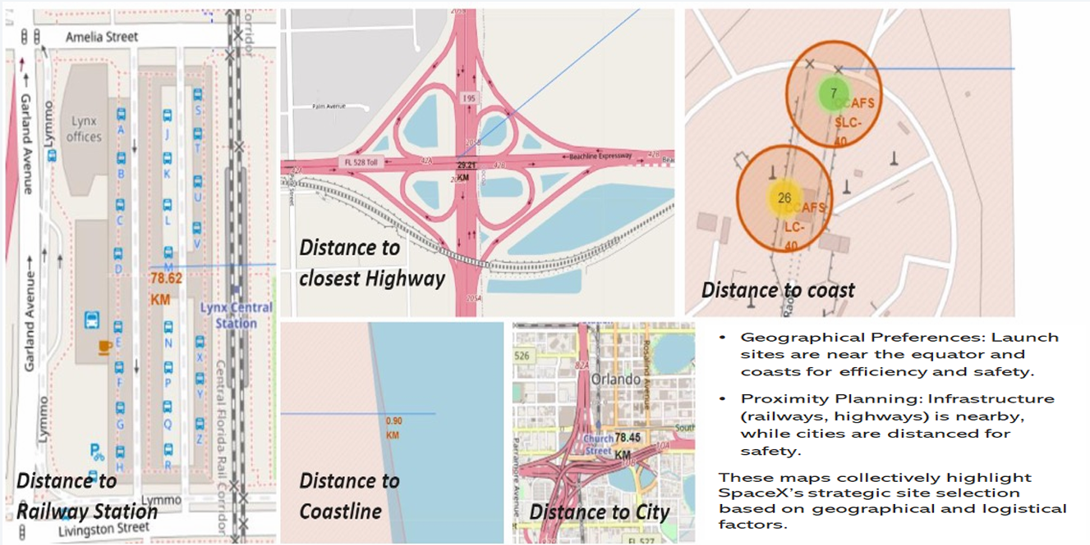
Launch Site Distance to Landmarks

Slide 39

Section 4

Slide 40
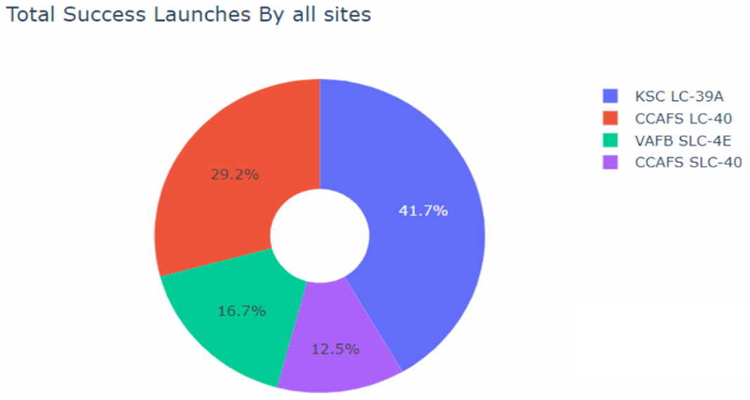
Pie Chart: Success Count by Site
We can see that KSC LC-39A had the most successful landings.

Slide 41
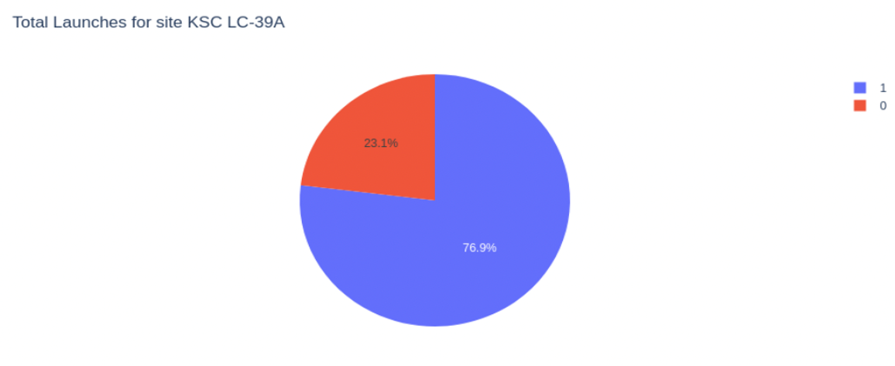
Highest Success Ratio
KSC LC-39A achieved a 76.9% success rate while getting a 23.1 failure rate.

Slide 42
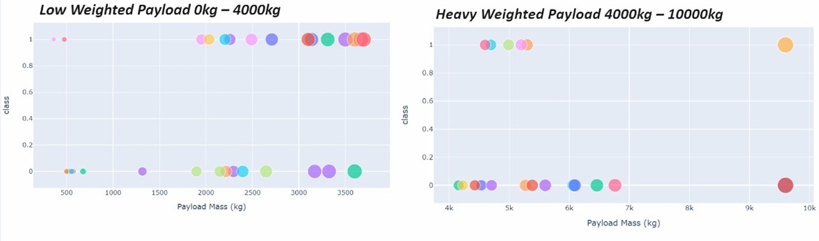
Payload vs. Outcome Scatter Plot
We can observe that low weighted payloads have higher success rates than heavy weighted payloads.

Slide 43

Section 5

Slide 44
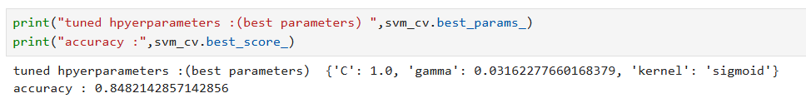
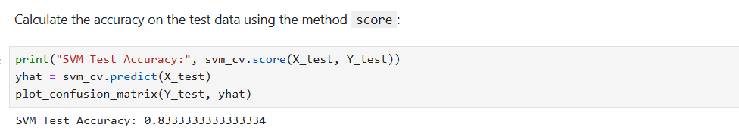
Classification Accuracy
SVM was selected as the best model after parameter tuning, which showed accuracy on validation data: 84.64% and accuracy on test data: 83.33%

Slide 45
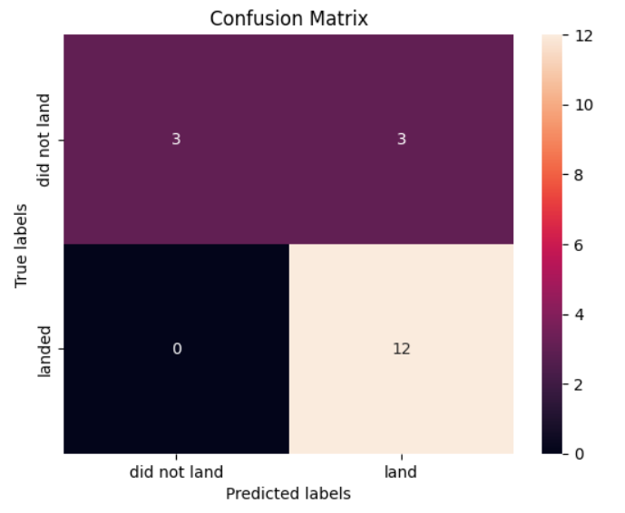
Confusion Matrix
The accuracy of 83.33% shows that the model is good enough, with 83.33% correct predictions out of all predictions.

Slide 46
Conclusions
Key success factors: Launch site, payload mass, and orbit type.
Decision Tree model reliably predicts landing outcomes.
Interactive tools (Folium, Dash) enhance data-driven decision-making.
Recommendations: Target high-success orbits and optimize payload ranges.

Slide 47
Appendix
Links to GitHub repositories for full documentation: https://github.com/rinto-octavian/SpaceY-Data-Science

Slide 48


